Slide 1
PREDICTION OF THE EMOTION - RESULTS
Bartłomiej koptyra
Sebastian Smolarczyk
Mateusz guściora

Slide 2
RECAP
Prediction of the emotion
Continuous bag of words model architecture
Chosen methods: decision tree, SVM, Neural Network

Slide 3
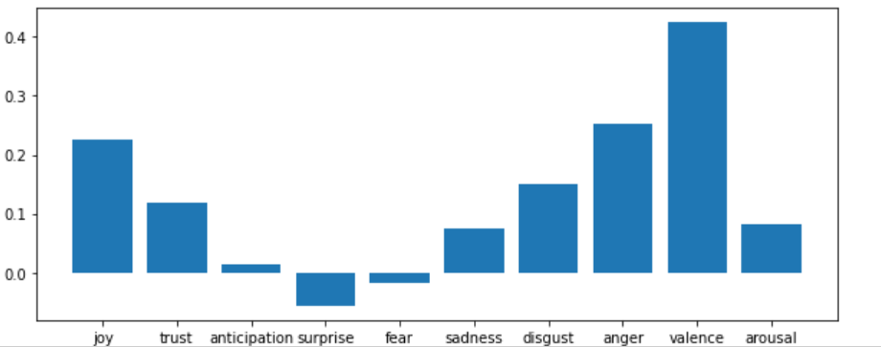
SVM

Slide 4
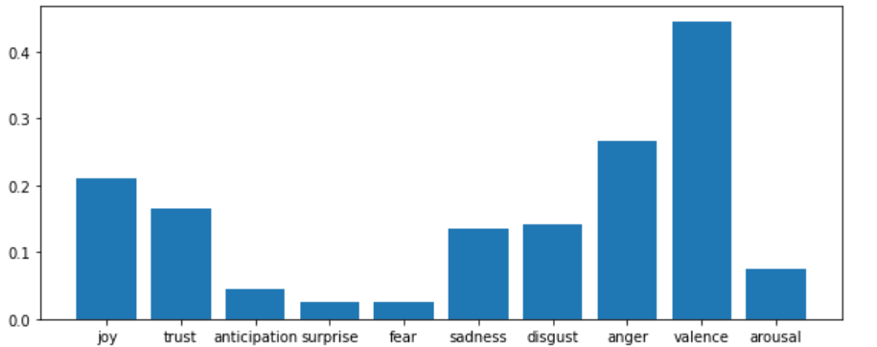
NEURAL NETWORK ( MLPRegressor )

Slide 5
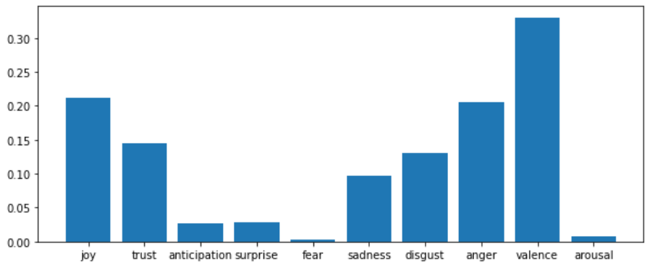
DECISSION TREE

Slide 6
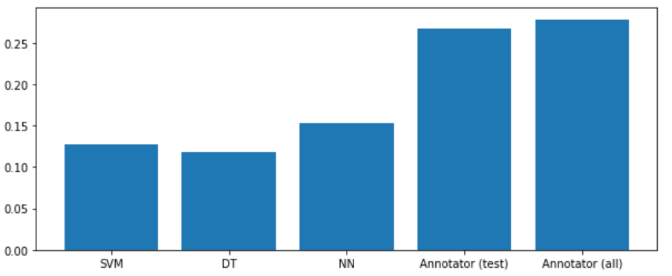
COMPARISON OF METHODS

Slide 7
CONCLUSIONS
Regression methods
Neural network of the selected methods had best results
Anticipation, suprise, fear had lowest results and valency highest in all methods

Slide 8
THANK YOU

